Slide 1
Introduction to Database Systems Group Project:Library Database
Group: 5A
Group member list:
Lai Kin Long,20212046(Project leader+ Database designer+ SQL programmer)
JIAN Chun Hin,20207461(SQL programmer + project report writer)
Yao Yi Tong,20217036(user representative + Database designer)
Li Pui Lam,20214909( User representative + Quality assurance)

Slide 2
Introduction
User requirement
Database model introduction
Table & ER Diagram
SQL Code & Requirement
Database Testing
Further Development
Conclusion

Slide 3
Background information
Develop libarary system
For student use and staff maintenance more effectively

Slide 4
Credits policy
Credits | Maximum borrowing numbers
76 - 100 | 15 book and 2 devices
51 - 75 | 10 book and 2 devices
26 - 50 | 5 book and 1 device
1 - 25 | 3 book and 1 device
0 or lower | 0 book and device
76 – 100
51 - 75
26 - 50
1 – 25
0 or lower

Slide 5
Increase Credit
Donate $10 = 1 credit

Slide 6
Decrease Credit Reasons
Rules for the library (Do not break the rules, otherwise your credit will decrease)
1. Do not damage Books and other library materials 2. Patrons should be quiet while inside the library. 3. Cell phones should be turned off or put in silent mode while in the library. 4. Food and drinks are not allowed in the library. 5. No alcoholic beverages are allowed in the library. 6. The library's devices and internet connection should be used for educational and research purposes only. 7. Patrons should not smoke or use tobacco products in the library. 8. Patrons should not bring pets or animals into the library, except for service animals. 9. Gambling is not allowed in the library. 10. Illegal or unethical activities are not allowed in the library. | (-5) (-5) (-5) (-5) (-5) (-5) (-5) (-5) (-5) (-5)

Slide 7
Decrease the credit
Punishment of overdue (Do not return books late, otherwise your credit will decrease) The credits decrease will follow the equation
Credit reduced = Number of overdue book(s) * Overdue days
Punishment of device overdue (Do not owe return devices late, otherwise your credit will decrease) The credits decrease will follow the equation
Reduce credit = Number of devices * Overdue days

Slide 8
Our library
We have 2319 Books
We have 1000 registered students
We have 111 records
We have 15 devices

Slide 9
User Requirment
User: Student and library administer(staff)
Book information management
Student information management
Device information management
Staff information management
Book borrowing/returning procedures
Device borrowing/returning procedures
Book borrowing/returning record
Donation record (for credit increasing)
Punishment record (for student’s credit decreasing)

Slide 10
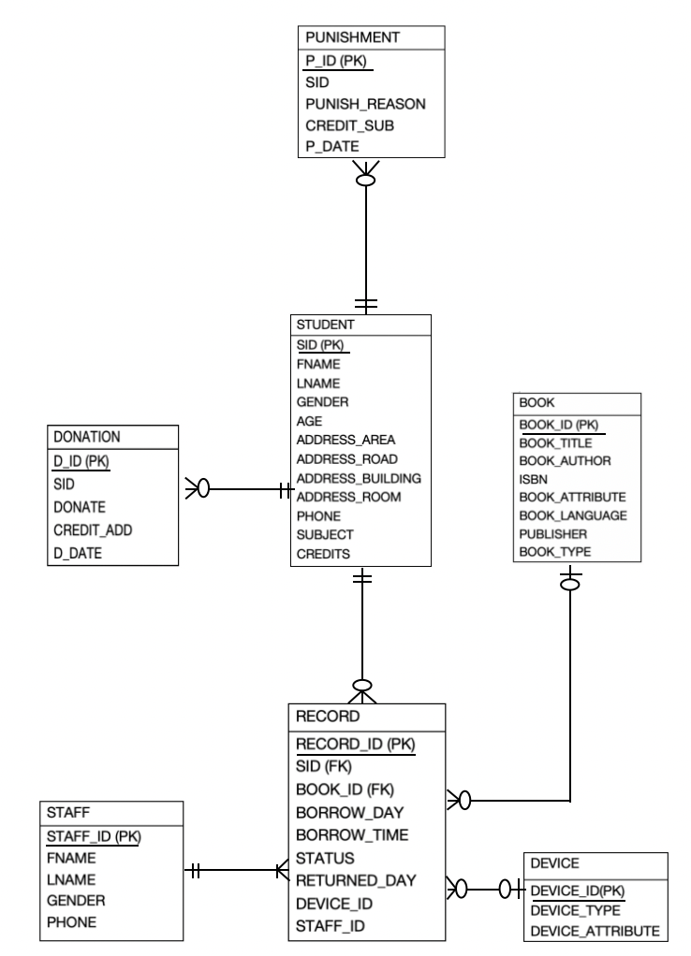
Entity Relationship Diagram

Slide 11
Database Model
Seven tables
RECORD
STUDENT
BOOK
DEVICE
STAFF
DONATION
PUNISHMENT

Slide 12
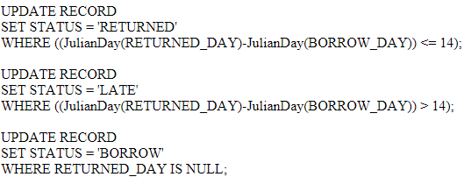
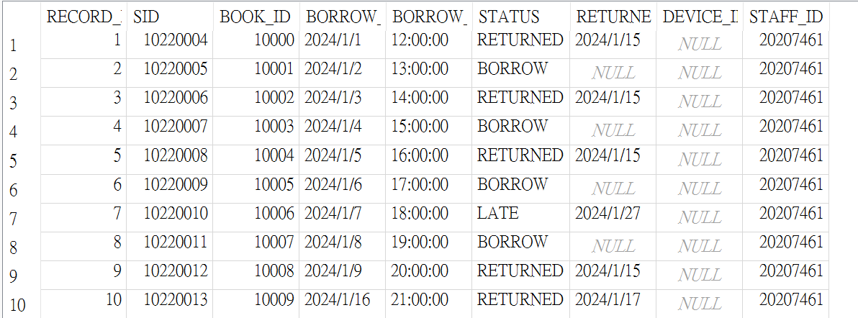
Data to be computed
Table: RECORD
Code and result

Slide 13

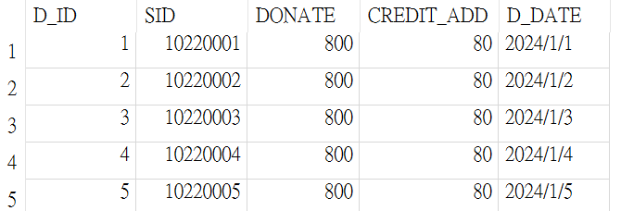
Data to be computed
Table: DONATION
Code and result

Slide 14
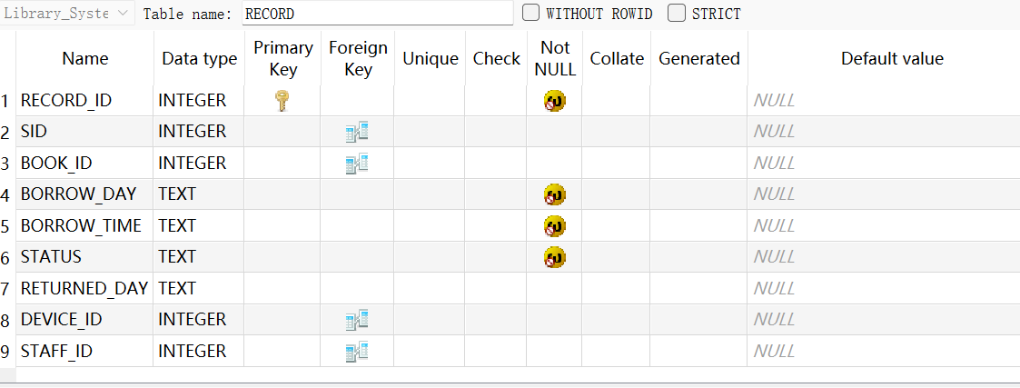
Table - RECORD

Slide 15
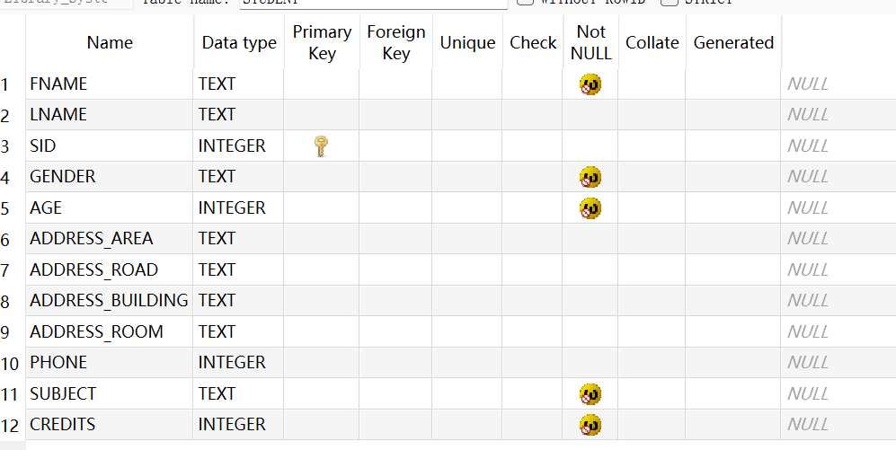
Table - STUDENT

Slide 16
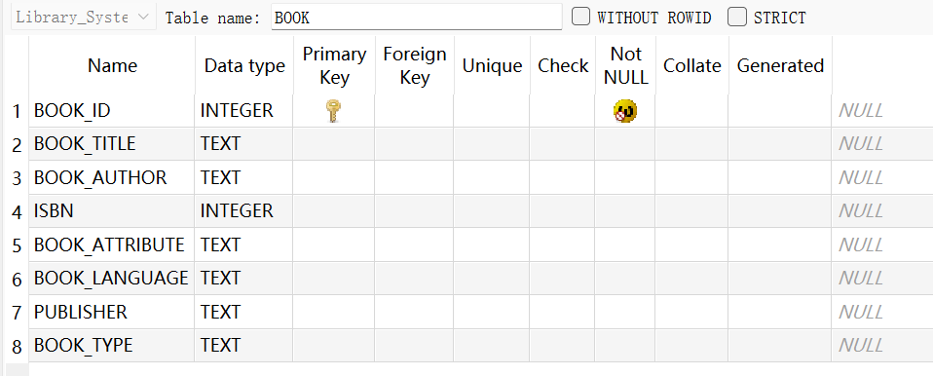
Table - BOOK

Slide 17
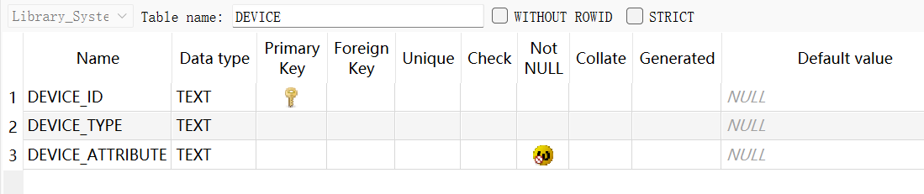
Table - DEVICE

Slide 18
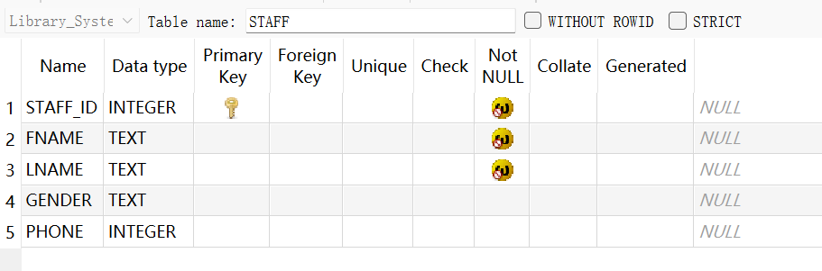
Table - STAFF

Slide 19
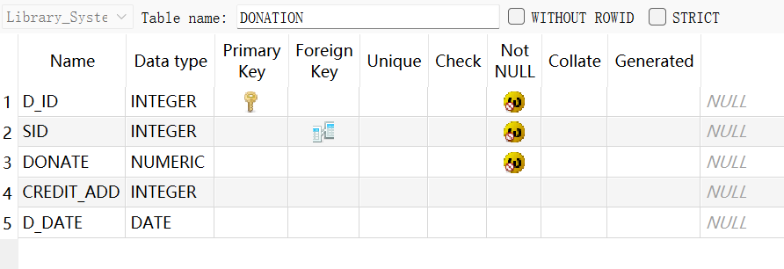
Table - DONATION

Slide 20
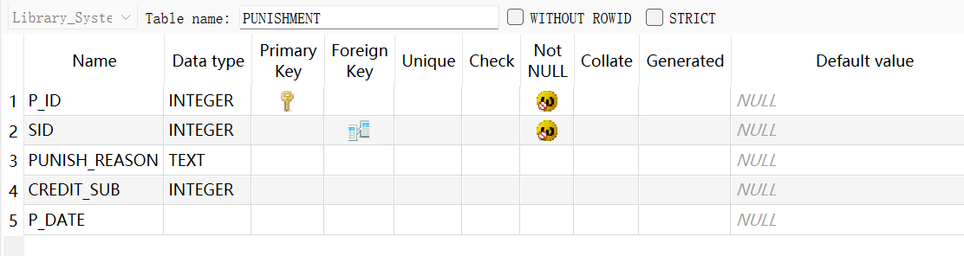
Table - PUNISHMENT

Slide 21
SQL Code List
For Students | For administers
1. Check student own record (For RECORD table) | 8. Check student late returned record/ borrowing record/ returned record (For advanced checking of RECORD table)
2. Check book available or not (For BOOK table) | 9. Check the quantity of book in the library (in different type) (For advanced checking of BOOK table)
3. Check self-information (For STUDENT table) | 10. Find the favorite book type in the library (in gender/ age) (For advanced checking of BOOK table + Link with the STUDENT / RECORD table)
4. Check donate record (For DONATION table) | 11. how many students always borrow the book/device (For advanced checking of STUDENT table)
5. Check punishment record (For PUNISHMENT table) | 12. Who is the most hardworking staff (For STAFF table)
6. Check device available or not (For DEVICE table)
7. Check the book information (For BOOK table)

Slide 22
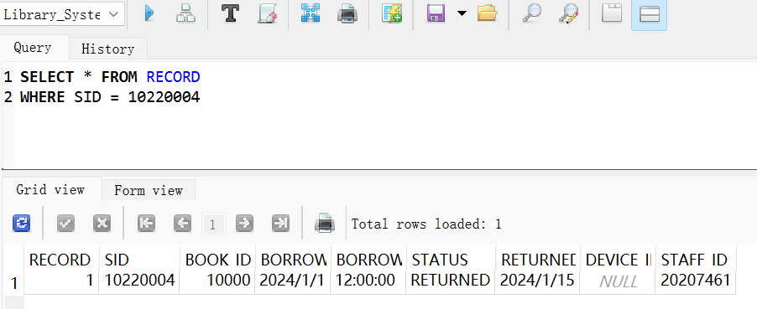
1. Check student own record (For RECORD table)

Slide 23
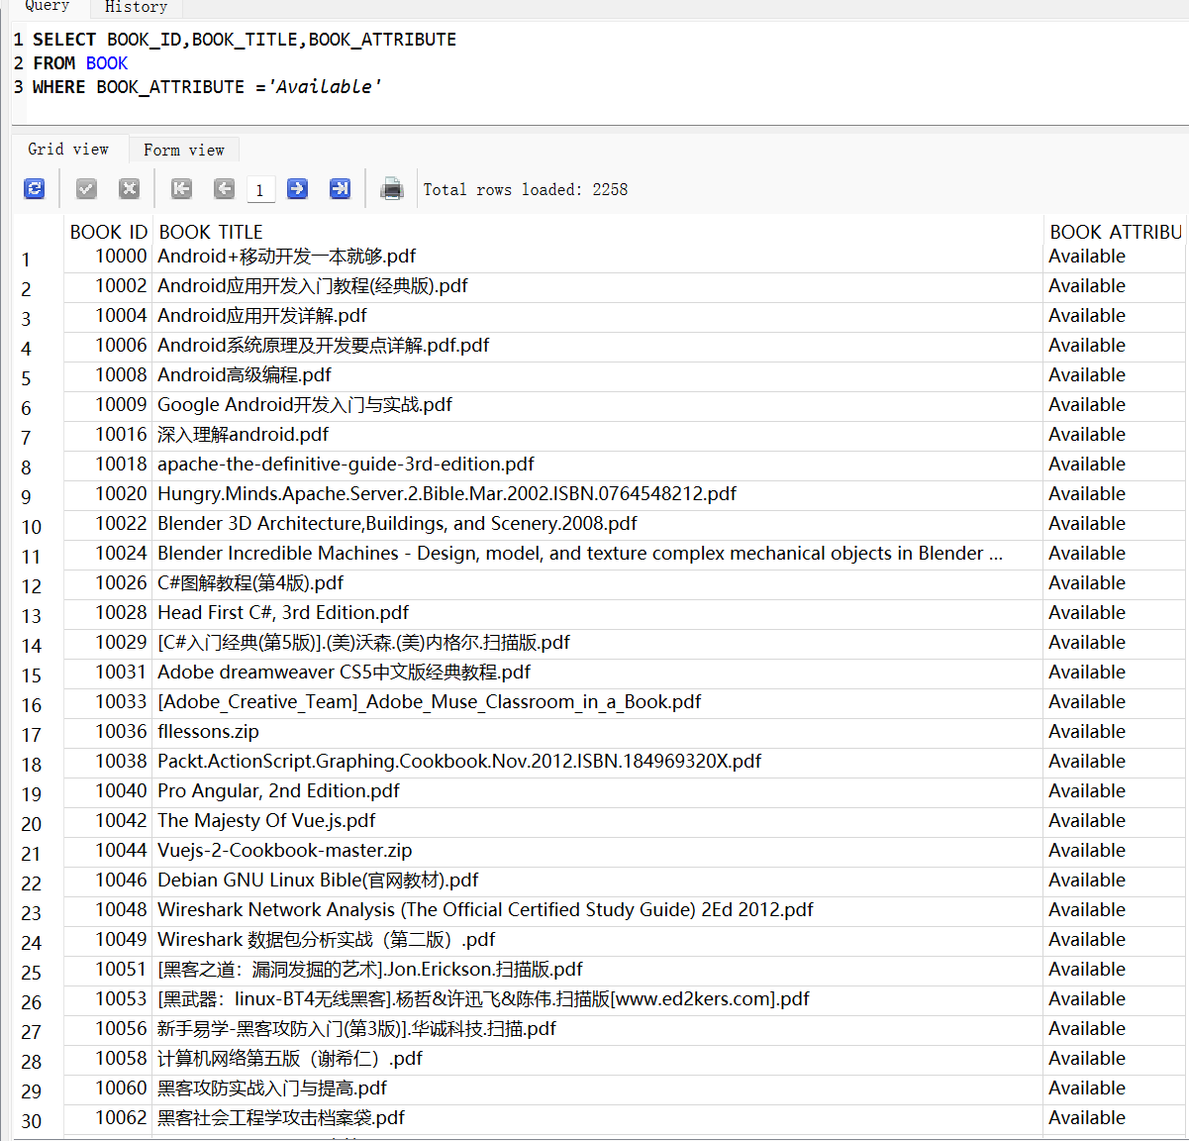
2. Check book available or not (For BOOK table)

Slide 24
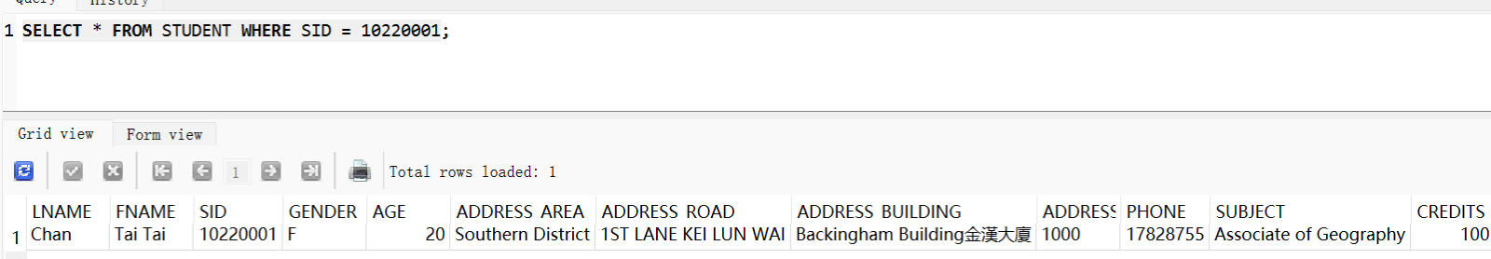
3. Check self-information (For STUDENT table)

Slide 25
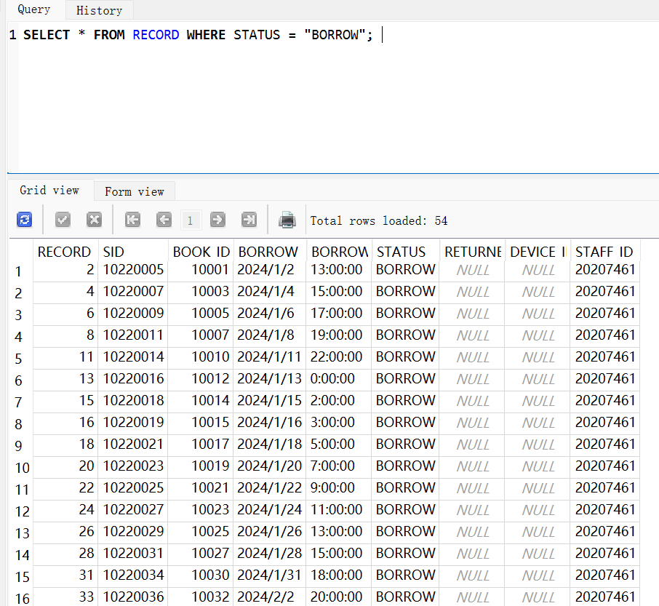
4. Check student late record/ borrowing record/ returned record/ late returned record

Slide 26
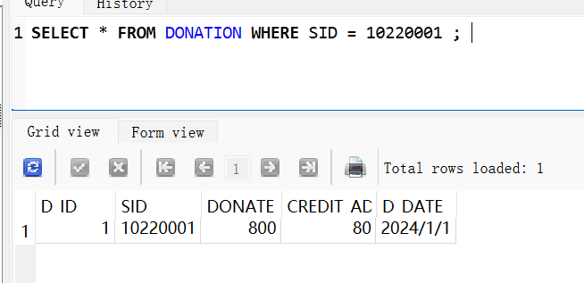
4. Check donate record

Slide 27
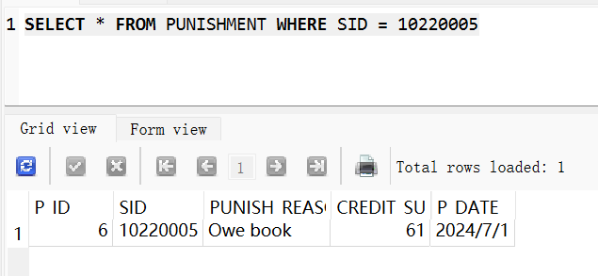
5. Check punishment record

Slide 28
Database Testing
Database testing
Tested retreival of different types of data
Data included in database refelcts normal user data input and usage
Tested muitiple entries and data retrive request
Data and sql code works in situations defined
Results are consistant with the expected outcome

Slide 29
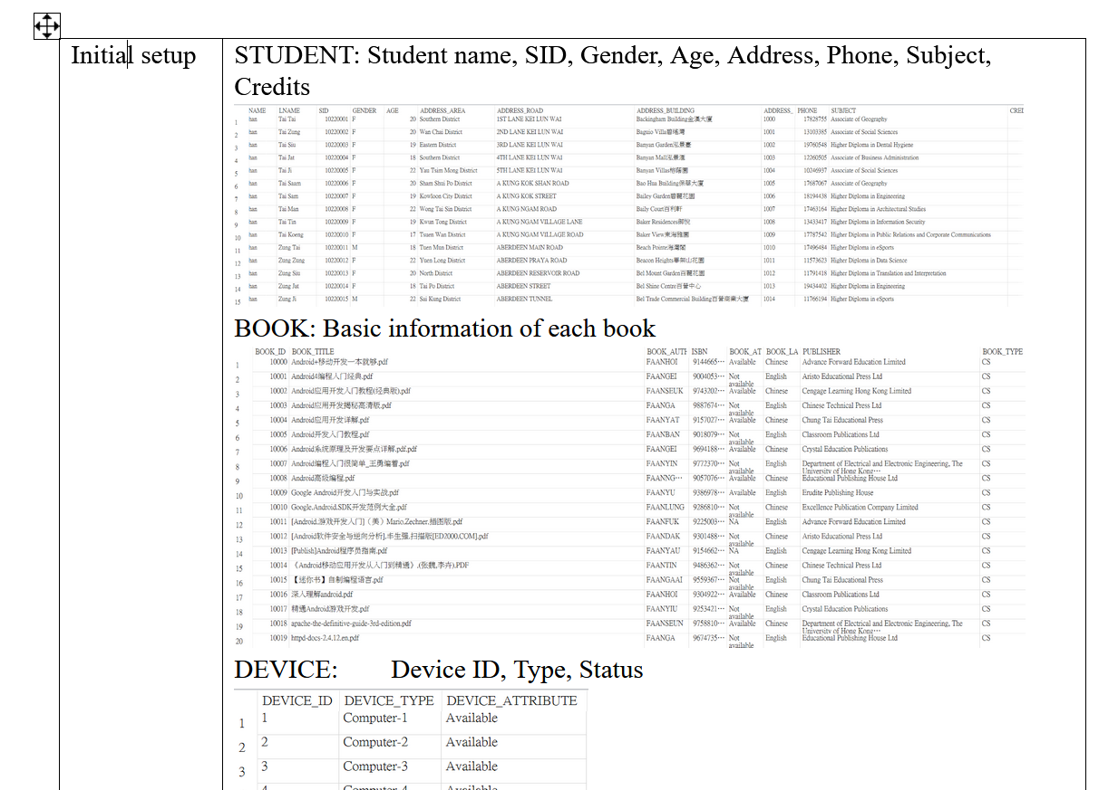

Slide 30
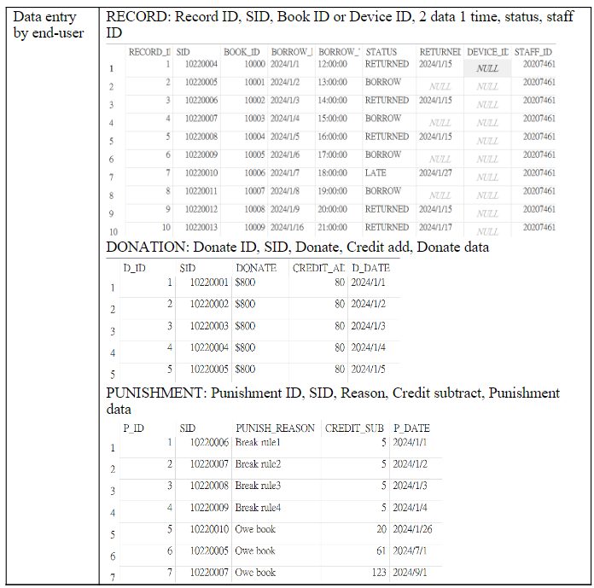

Slide 31
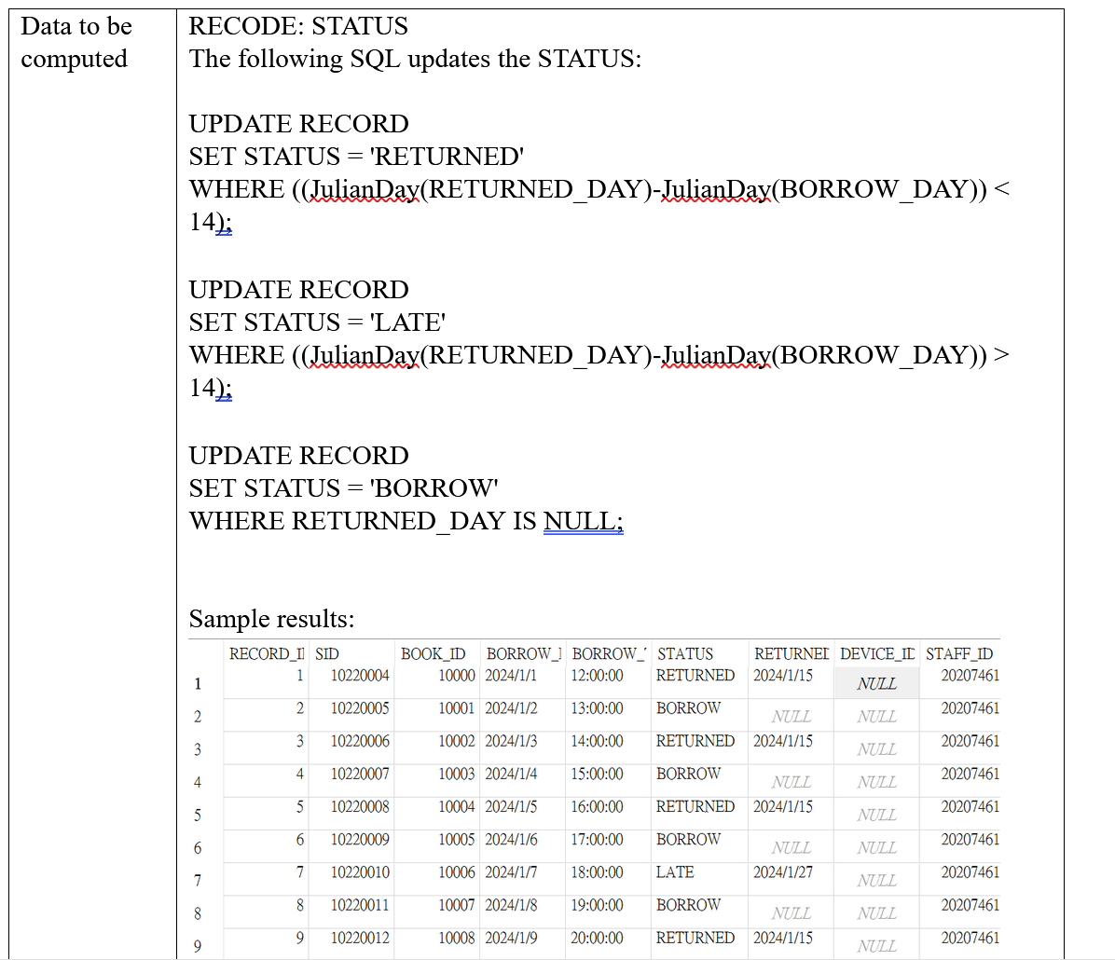

Slide 32
Further Development
As for our further development plan, we considered adding some new things which are......
Library Activity
- Student can join the library activity to increase their library’s credit
- Let the library staff have more work to do, utilizing the library human resource appropriately
Advanced User service supporting (VIP)
- Provided a better reading environment (e.g. VIP Reading Room/ Afternoon tea provided)
- Book Recommending (each week)
- Borrowing more book without the credit limit
- Book reservation
- Provided the electric book resource
Journal service supported
- Provided journal article (e.g. Science & Nature)
- Provided article repeated content checking service

Slide 33
Conclusion
After the quality testing, no errors appeared in the database. Also, the database design fulfilled the basic demands of students and library administrators. We evaluated that this database can be used in real-life situations.
In the future, we also hope to add more functions and different content according to the above plan, to enhance our service and database efficiency. We believe that our library database can acquire a good performance in daily life.

